Slide 1
Machine Learning
Internship Project - 1

Slide 2
E-retail factors for customer activation and retention: A case study from Indian e-commerce customers

Slide 3
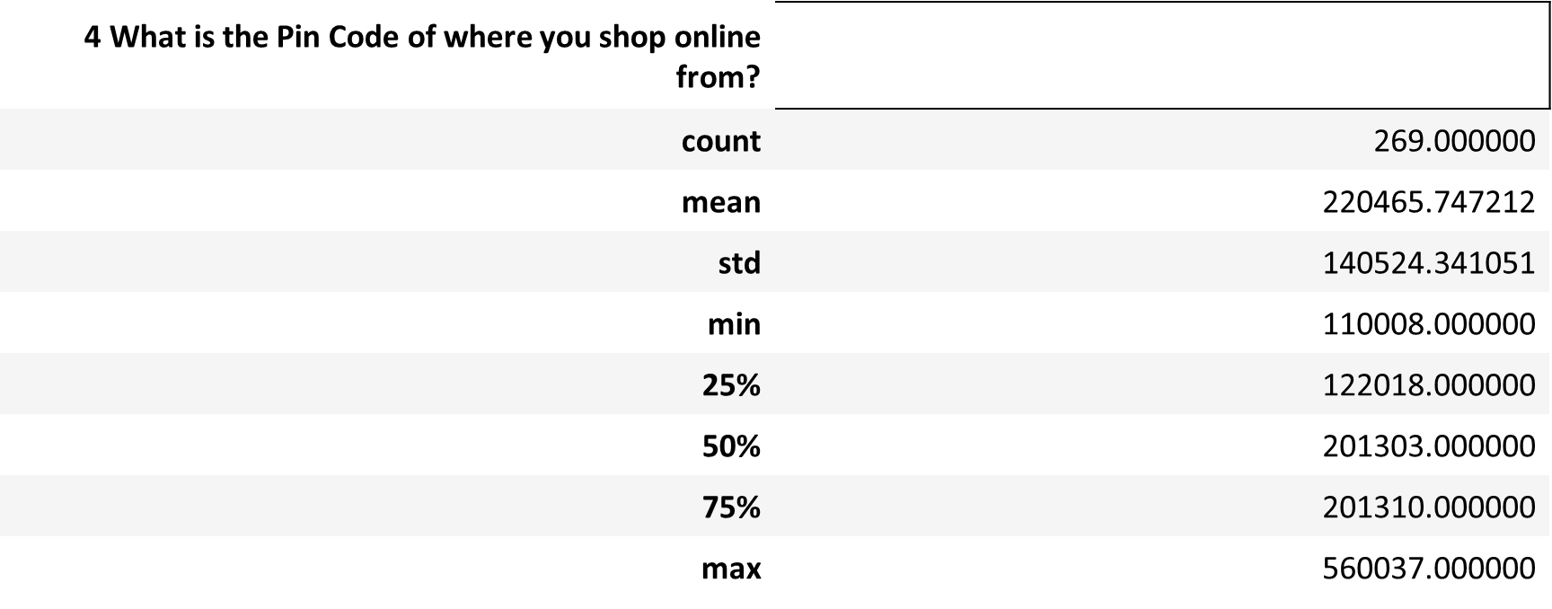
df.describe()

Slide 4
df.isnull().sum()
1Gender of respondent 0
2 How old are you? 0
3 Which city do you shop online from? 0
4 What is the Pin Code of where you shop online from? 0
5 Since How Long You are Shopping Online ? 0
--
Longer delivery period 0 Change in website/Application design 0
Frequent disruption when moving from one page to another 0
Website is as efficient as before 0
Which of the Indian online retailer would you recommend to a friend? 0
Length: 71,
dtype: int64

Slide 5
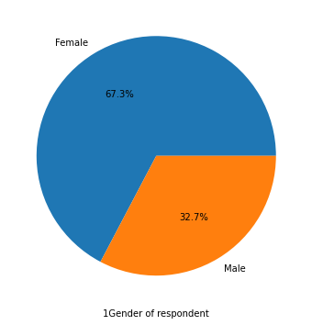
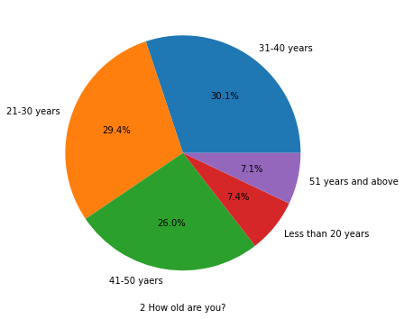
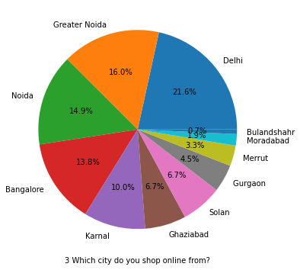
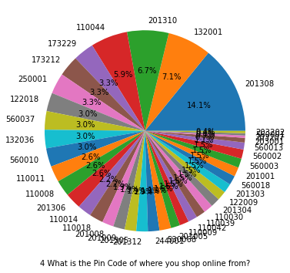
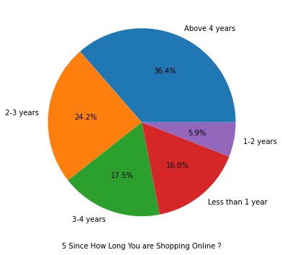
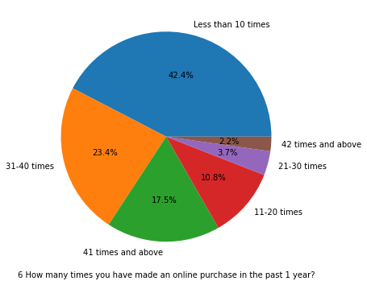
Data Analysis using personal_info

Slide 6
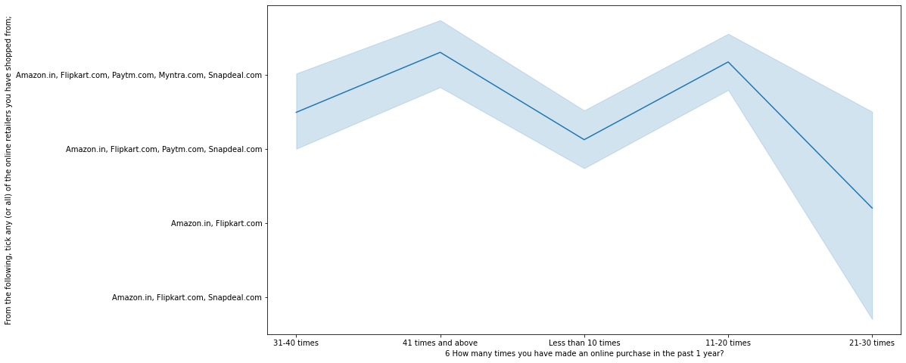
Analysis based on various factors

Slide 7
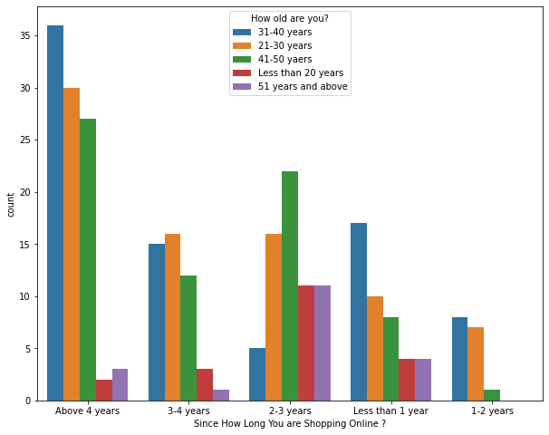
Online Retailing:

Slide 8
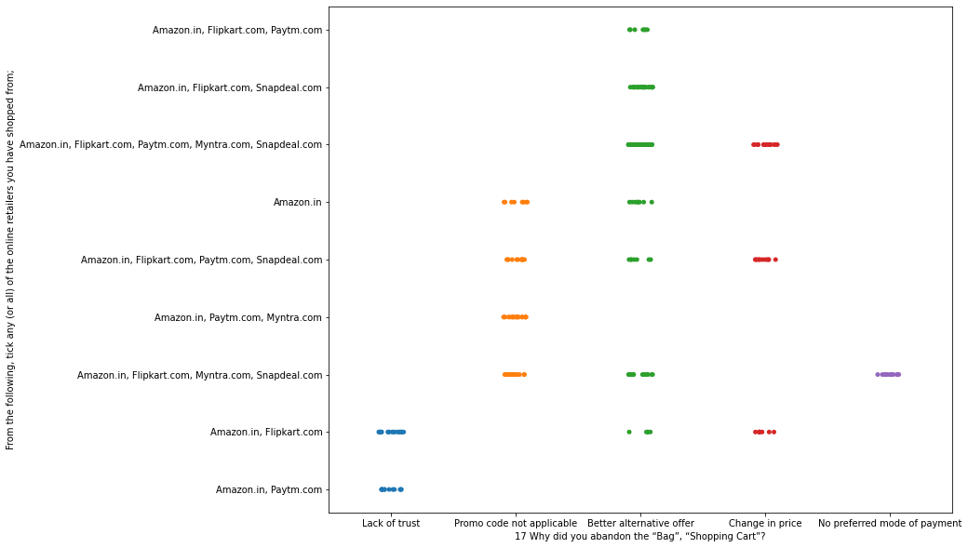
Branding Image

Slide 9
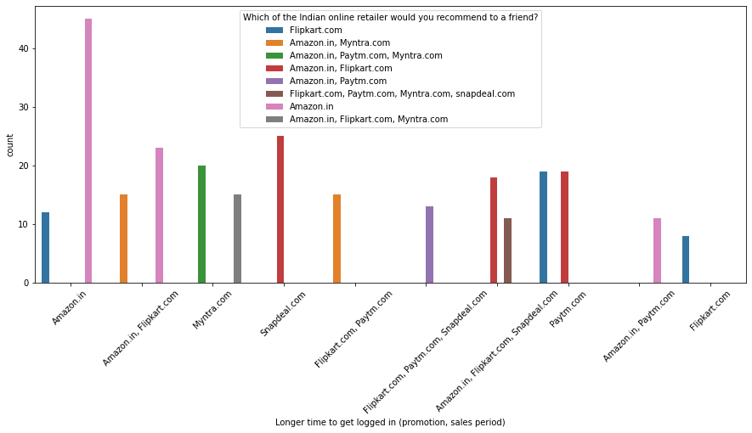
Loyalty

Slide 10
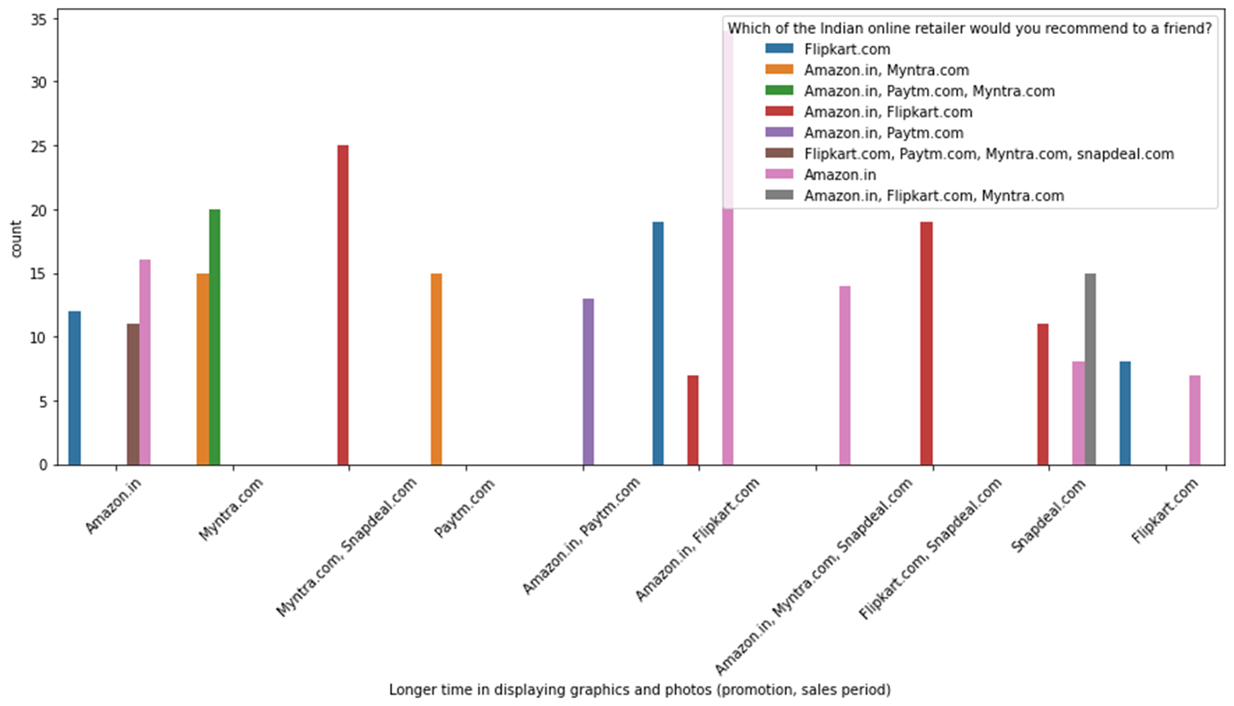

Slide 11
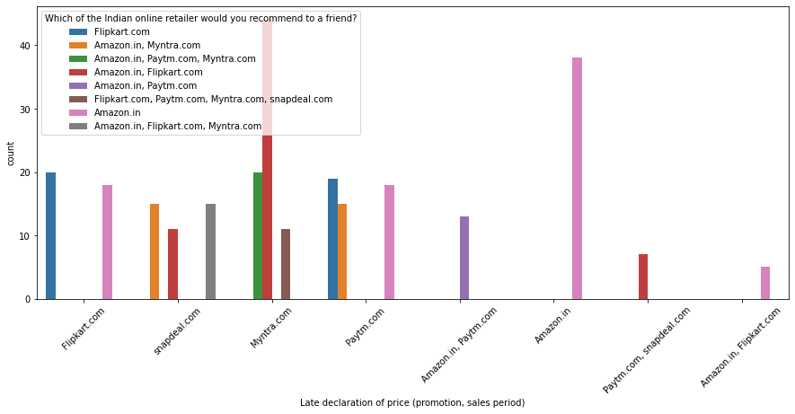

Slide 12
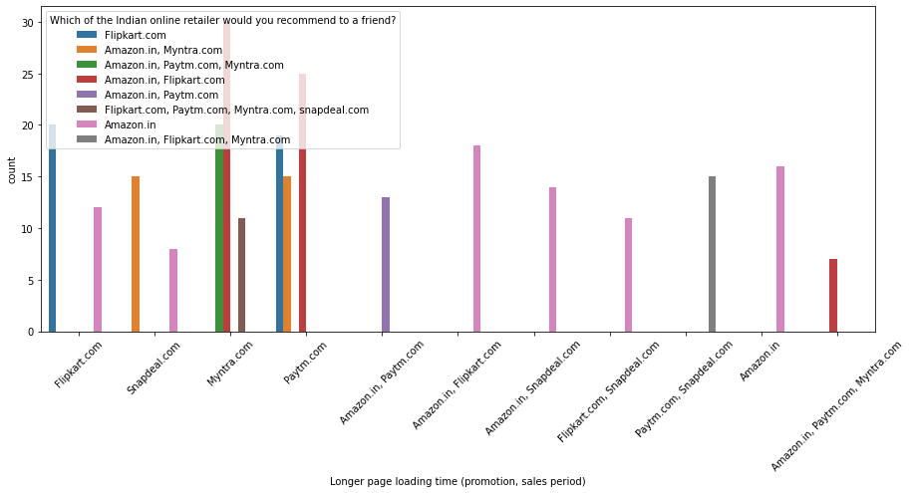

Slide 13
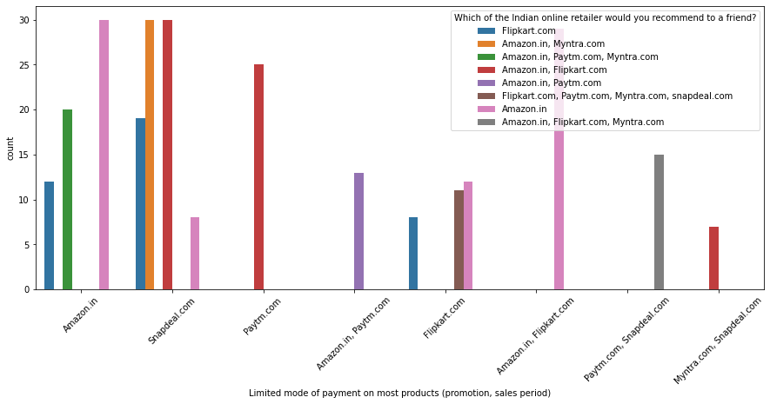

Slide 14
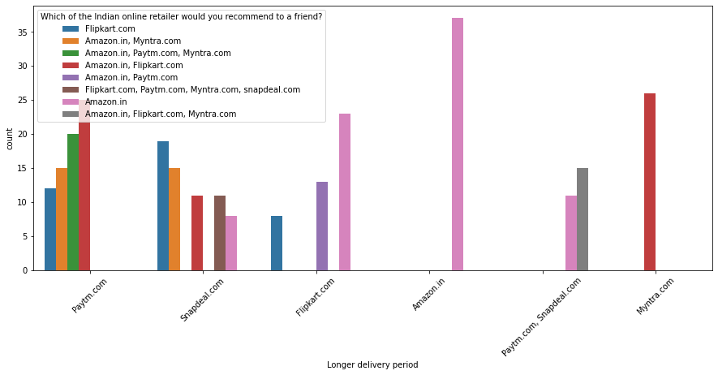

Slide 15
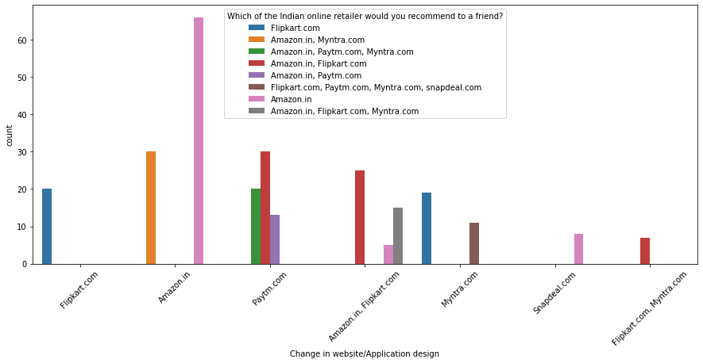

Slide 16
